Slide 1
CLUSTERING techniques using COVID-19 data
Jeon, DoYeong Soongsil University, Seoul, Korea http://soft.ssu.ac.kr
July 2020

Slide 2
Contents
Unit | Contents | slide#
1 | What can do with Clustered COVID-19 Data | 3
2 | Test Case | 8
3
4
5

Slide 3
Unit 1
What can do with Clustered COVID-19 Data

Slide 4
What can do with clustered corona data
4 Ways to use
1. Calculating the severity and risk rating of users
2. Estimating the current risk rating of activity space of the user.
3. Predicting the severity user will have and the risk rating to be updated when user will visit a specific area
4. Calculating the change of risk rating in the specific space when the user will visit there.

Slide 5
Benefits
1. Calculating the severity and risk rating of users
If the user was in the same space as the infected person/contact, the severity and risk rating of the user can be calculated in real time according to the information of the infected person/contact and the user information.
Benefits
Because the risk of Covid-19 differs depending on the user's age, health information, and gender, this technique can be used to show the risk customized to the user.
Depending on the level of risk, the user can see which ratings users belong to and help to decide what actions to take.

Slide 6
Benefits
2. Estimating the current risk rating of activity space of the user
It is possible to estimate the risk rating of specific place within the user's life radius with the data of the infected/contact person and the user information.
3. Predicting the severity and the risk rating to be updated
It can predict the severity user will have and the risk rating of the user to be updated when you will visit a specific area .
Benefits
It can raise the user’s awareness by quantifying the severity and risk rating using data about the current situation.

Slide 7
Benefits
4. Calculating the change of risk rating in the specific space
When a user will visit a specific area, the severity and risk rating of the residential area to be updated can be calculated according to the user's risk rating to be updated.
Benefits
Socially, it shows the individual's vague awareness with specific data figures.
It can trigger more defensive actions and help build a social safety net in that individuals realize the dangers of action.

Slide 8
Unit 2
Test Case

Slide 9
1. Calculating the severity and risk rating of users
Overview of test case
Language: Python
Library used
pandas
sklearn
matplolib
pyclustering
Distance Function
Weighted Euclidean Distance Function
Data used
100 people generated randomly
ID
Age
Address
Covid Status
Inccured Date
Severity

Slide 10
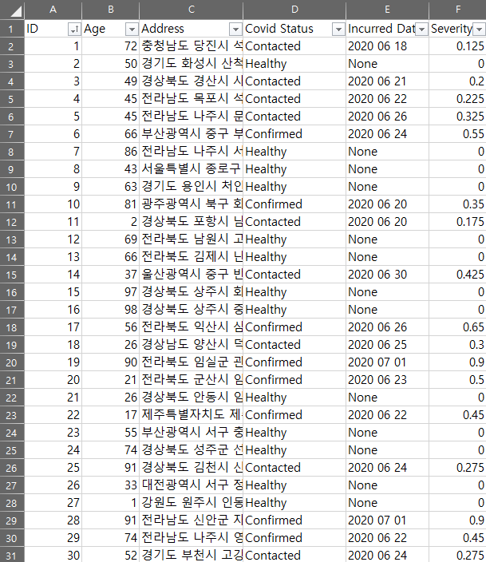
1. Calculating the severity and risk rating of users
Data used
30 people of the data

Slide 11
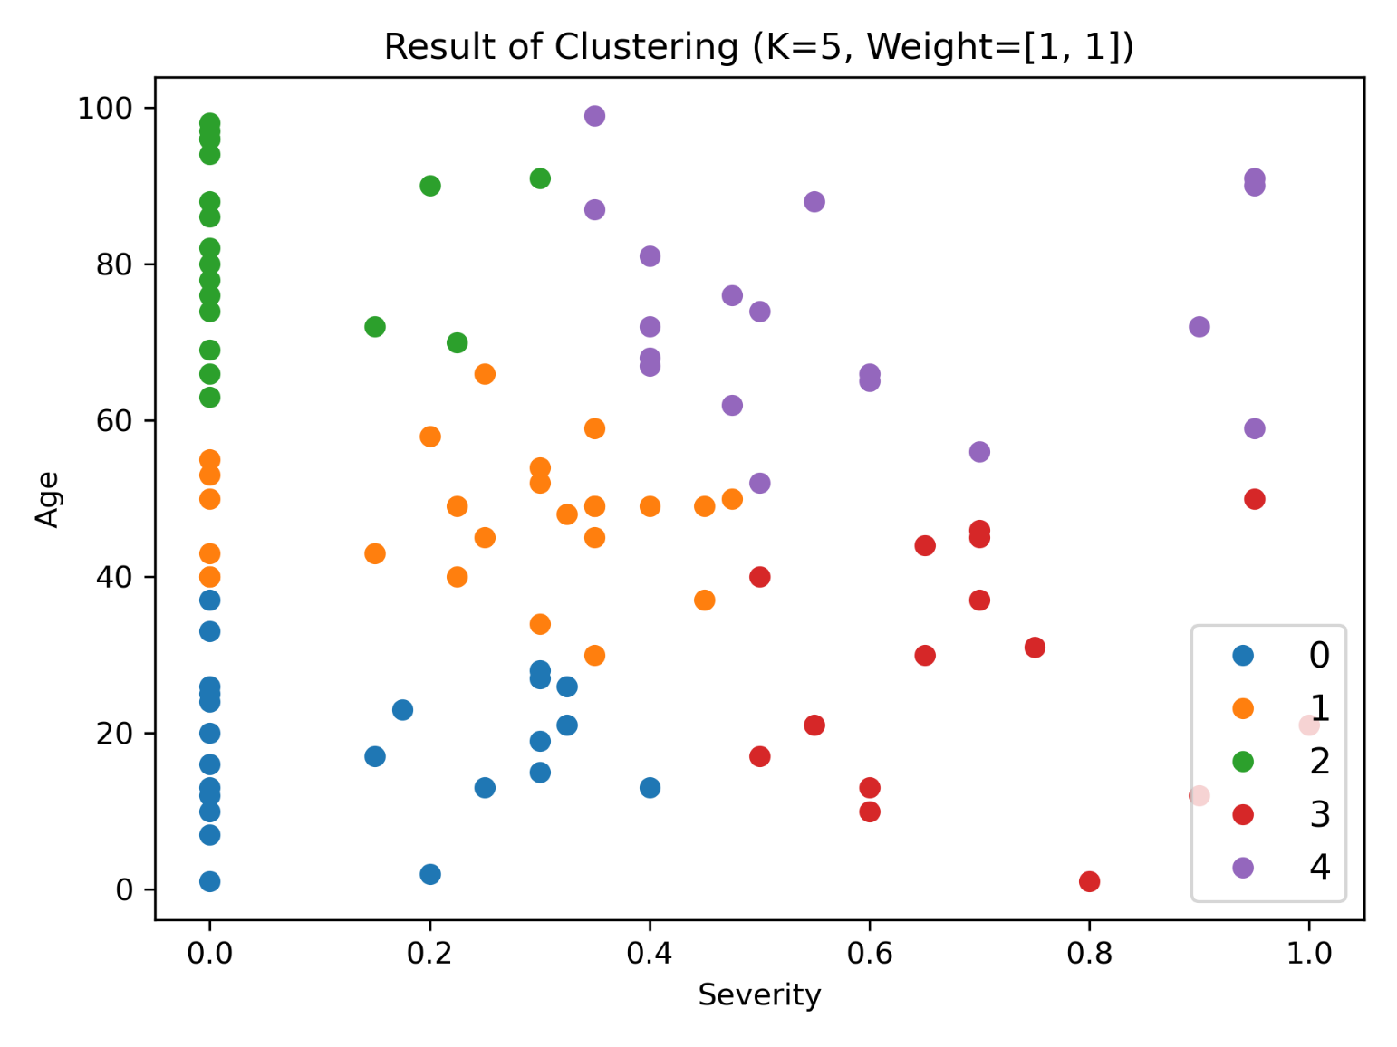
1. Calculating the severity and risk rating of users
Results classified into 5 clusters
Features used: Severity, Age

Slide 12
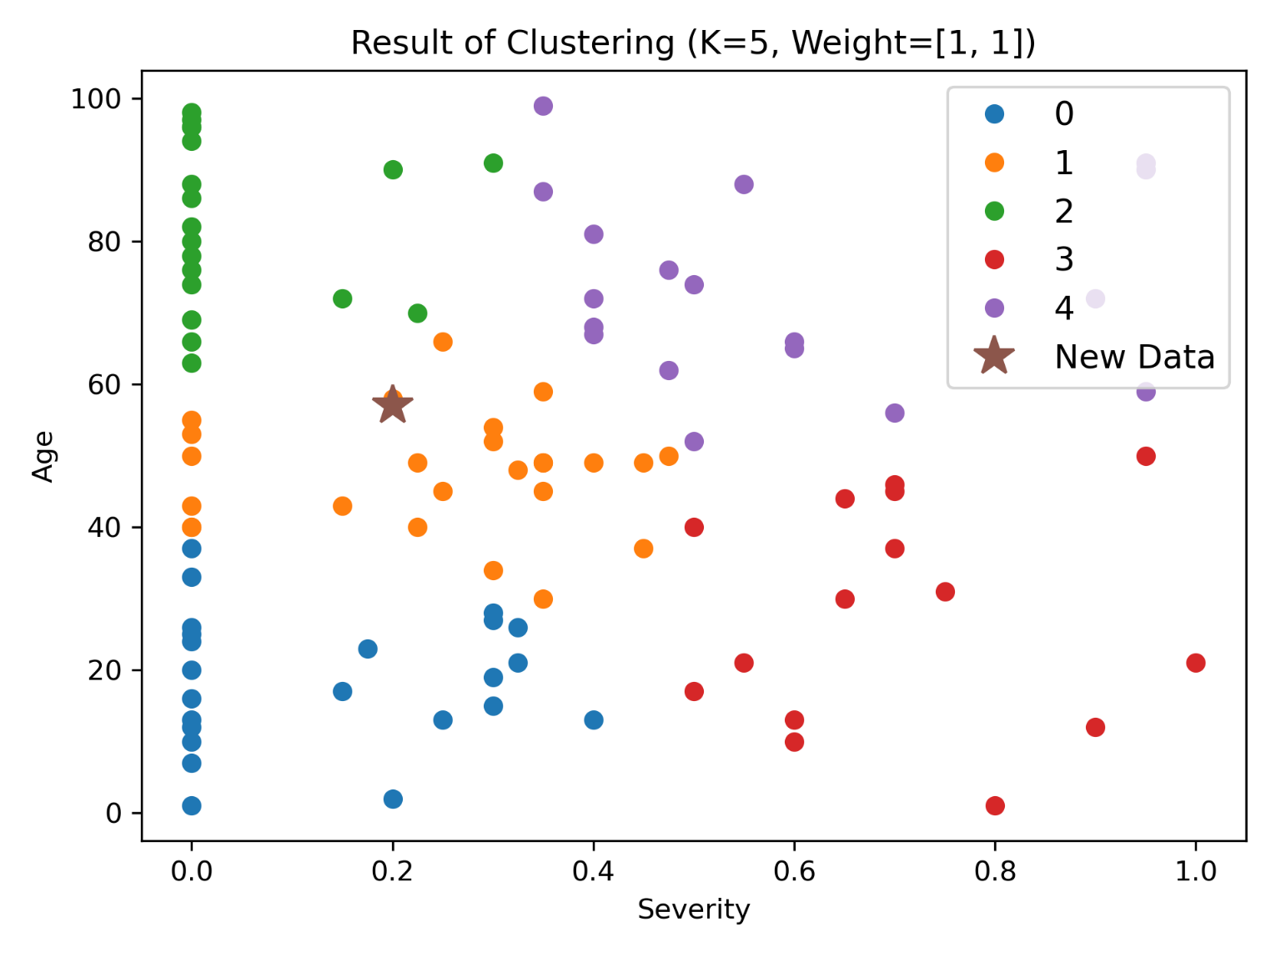
1. Calculating the severity and risk rating of users
When User's information is added
Features used: Severity, Age

